Slide 1

Capital Budgeting
Msc Corporate Financial Management
Lille Campus - 18 hours
Skema Business School
Step 3 : Tools : Cost of debt, Cost of equity and cost of capital
Pr. Sébastien DEREEPER
Sebastien.Dereeper@skema.edu
Course Based on :
J. Berk & P. De Marzo - Corporate Finance - Pearson, 2024
Notes:
If this PowerPoint presentation contains mathematical equations, you may need to check that your computer has the following installed:
1) Math Type Plugin
2) Math Player (free versions available)
3) NVDA Reader (free versions available)

Slide 2
Outline
1. The Equity Cost of Capital
2. The Market Portfolio
3. Beta Estimation
4. The Debt Cost of Capital
5. A Project’s Cost of Capital
6. Project Risk Characteristics and Financing
7. Final Thoughts on Using the C A P M

Slide 3
Learning Objectives (1 of 4)
Estimate a company’s cost of capital using the C A P M equation for the Security Market Line.
Describe the market portfolio and how it is constructed in practice.
Discuss the attributes of a value-weighted portfolio.
Describe common proxies for the market return and the risk-free rate.

Slide 4
Learning Objectives (2 of 4)
Define alpha and beta and explain how they are generally estimated.
Compare the use of average return versus beta and the S M L to estimate cost of equity capital.
Estimate the cost of debt, given a company’s yield to maturity, probability of default, and expected loss rate.

Slide 5
Learning Objectives (3 of 4)
Discuss the difference between the yield to maturity and the cost of debt when there is low versus high default risk.
Calculate the cost of debt given a company’s debt beta, the risk free rate, and the market risk premium.
Illustrate the use of comparable companies’ unlevered betas or unlevered cost of capital to estimate project cost of capital.

Slide 6
Learning Objectives (4 of 4)
Discuss the advantages of using several companies’ betas to estimate a project beta.
Define operating leverage and discuss its influence on project risk.
Calculate the weighted average cost of capital.
Discuss strengths and weaknesses of the C A P M.

Slide 7
1. The Equity Cost of Capital
The Capital Asset Pricing Model (C A P M) is a practical way to estimate
The cost of capital of any investment opportunity equals the expected return of available investments with the same beta
The estimate is provided by the Security Market Line equation:
Notes:
Long description:
r sub i baseline equals r sub f baseline plus beta sub i baseline times left parenthesis upper E left bracket upper R sub upper M k t baseline right bracket minus r sub f baseline right parenthesis. A text below the expression, left parenthesis upper E left bracket upper R sub upper M k t baseline right bracket minus r sub f baseline right parenthesis reads, risk premium for security i.

Slide 8
Example 1 (1 of 2)
Computing the Equity Cost of Capital
Problem
Suppose you estimate that Disney’s stock (D I S) has a volatility of 20% and a beta of 1.29. A similar process for Domino’s Pizza (D P Z) yields a volatility of 30% and a beta of 0.62. Which stock carries more total risk? Which has more market risk? If the risk-free interest rate is 3% and you estimate the market’s expected return to be 8%, calculate the equity cost of capital for Disney and Domino’s. Which company has a higher cost of equity capital?

Slide 9
Example 1 (2 of 2)
Solution
Total risk is measured by volatility; therefore Domino stock has more total risk than Disney. Systematic risk is measured by beta. Disney has a higher beta, so it has more market risk than Domino.
Given Disney’s estimated beta of 1.29, we expect the price for Disney’s stock to move by 1.29% for every 1% move of the market. Therefore, Disney’s risk premium will be 1.29 times the risk premium of the market, and Disney’s equity cost of capital is
Domino has a lower beta of 0.62. The equity cost of capital for Domino is
Because market risk cannot be diversified, it is market risk that determines the cost of capital; thus Disney has a higher cost of equity capital than Domino, even though it is less volatile.

Slide 10
2. The Market Portfolio (1 of 3)
Constructing the Market Portfolio
Market Capitalization
  The total market value of a firm’s outstanding shares

Slide 11
2. The Market Portfolio (2 of 3)
Value-Weighted Portfolio
  A portfolio in which each security is held in proportion to its market capitalization

Slide 12
Value-Weighted Portfolios
A value-weighted portfolio is an equal-ownership portfolio; it contains an equal fraction of the total number of shares outstanding of each security in the portfolio
Passive Portfolio
  A portfolio that is not rebalanced in response to price changes

Slide 13
Market Indexes
Report the value of a particular portfolio of securities
Examples
  S&P 500
    A value-weighted portfolio of the 500 largest U.S. stocks
  Wilshire 5000
    A value-weighted index of all U.S. stocks listed on the major stock exchanges
  Dow Jones Industrial Average (D J I A)
    A price weighted portfolio of 30 large industrial stocks

Slide 14
Investing in a Market Index
Index funds – mutual funds that invest in the S&P 500, the Wilshire 5000, or some other index
Exchange-traded funds (E T F s) – trade directly on an exchange but represent ownership in a portfolio of stocks
  Example: S P D R S(Standard and Poor’s Depository Receipts) represent ownership in the S&P 500

Slide 15
2. The Market Portfolio (3 of 3)
Most practitioners use the S&P 500 as the market proxy, even though it is not actually the market portfolio

Slide 16
The Market Risk Premium (1 of 2)
Determining the Risk-Free Rate
  The yield on U.S. Treasury securities
  Surveys suggest most practitioners use 10- to 30-year treasuries
The Historical Risk Premium
  Estimate the risk premium
  using the
  historical average excess return of the market over the risk-free interest rate

Slide 17
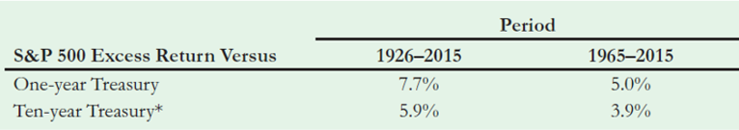
Table 1
Historical Excess Returns of the S&P 500 Compared to One-Year and Ten-Year U.S. Treasury Securities
*Based on a comparison of compounded returns over a ten-year holding period.
Notes:
Long Description:
The table headers are S and P 500 excess return versus, period: 1926 to 2015 1965 to 2015. The data listed row-wise is as follows: one-year treasury, 7.7 percent, 5.0 percent; ten-year treasury super asterisks, 5.9 percent, 3.9 percent. super asterisks based on a comparison of compounded returns over a 10-year holding period.

Slide 18
The Market Risk Premium (2 of 2)
A Fundamental Approach
  Using historical data has two drawbacks:
    Standard errors of the estimates are large
    Backward looking, so may not represent current expectations

Slide 19
3. Beta Estimation (1 of 3)
Using Historical Returns
  Recall, beta is the expected percent change in the excess return of the security for a 1% change in the excess return of the market portfolio
  Consider Callaway Golf Company stock and how it changes with the market portfolio

Slide 20
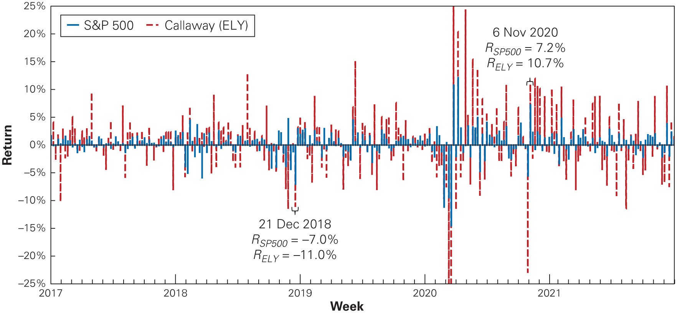
Figure 1
Weekly Returns for Callaway Golf’s Stock and for the S&P 500, 2017–2021
Notes:
Long Description:
The data on the graph are as follows: The x-axis shows the years ranging from 2017 to 2021 in increments of 1. The y-axis shows the return ranging from negative 25 percent to 25 percent in increments of 10. The graph shows that of the 60 pairs of bars that are plotted, Cisco’s direction matches the S and P 500’s 42 times, and Cisco’s absolute height, measured above or below zero, exceeded that of the S and P 500 42 times. The following dates have been distinctly marked on the graph: 21 December 2018: R subscript S P 500 equals negative 7.0 percent; R subscript E L Y equals negative 11.0 percent; 6 November 2020: R subscript S P 500 equals 7.2 percent; R subscript E L Y equals 10.7 percent.

Slide 21
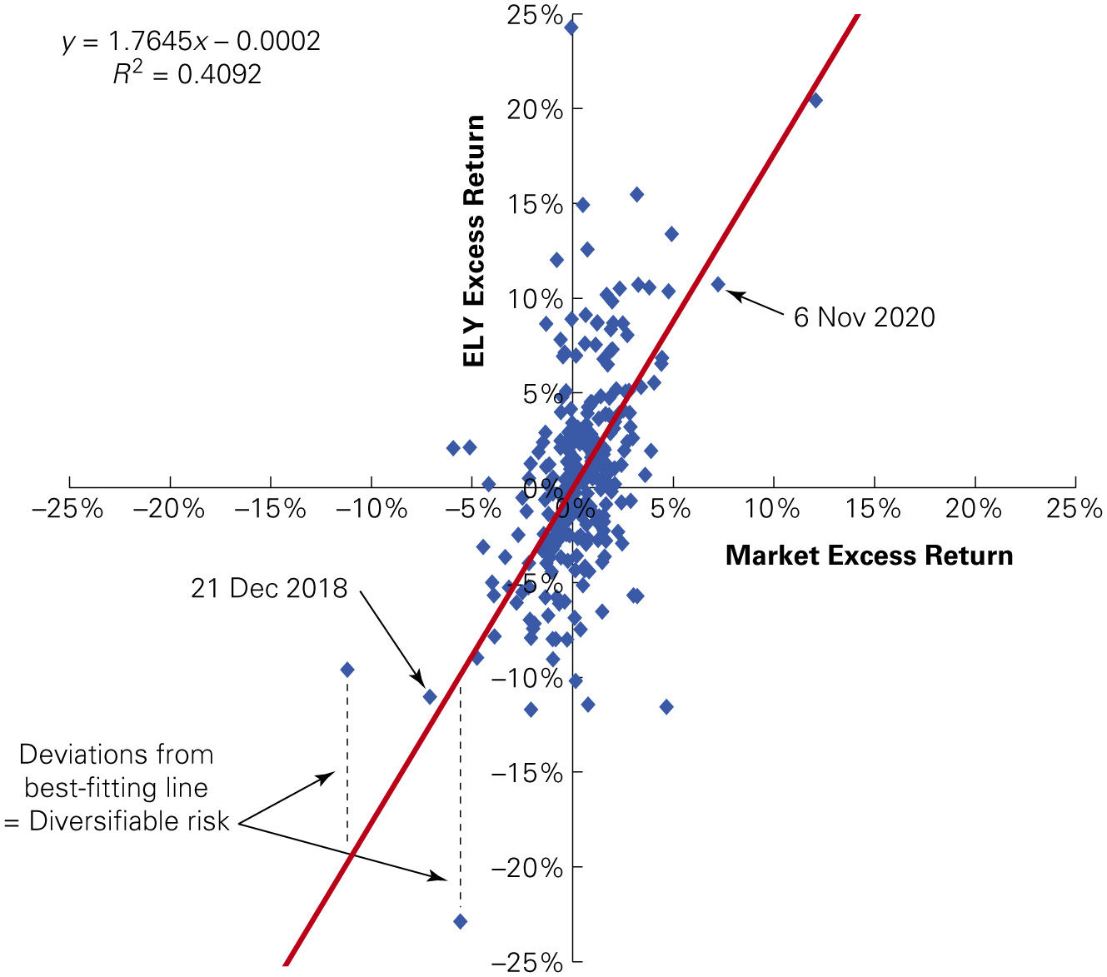
Figure 2
Scatterplot of Weekly Excess Returns for Callaway Golf Versus the S&P 500, 2017–2021
Notes:
Long Description:
Data depicted on the graph are as follows: The x-axis represents the Market excess return ranging from negative 25 percent to 25 in increments of 5. The y-axis represents the E L Y excess return ranging from negative 25 percent to 25 in increments of 5. An inclining line is drawn from values (negative 13, negative 25) passing through (0,0) to (13, 15). It shows a scattered plot between negative 10 and positive 10 on the y-axis and negative 5 and positive 5 on the x-axis. Two points labeled on the graph are as follows: 1. 21 December 2018: (negative 7, negative 12) and 2. 6 November 2020: (7, 12). It shows a dotted line from (negative 11, negative 9) and (negative 5, negative 23) intersecting the inclining curve. These are labeled deviation from best-fitting line equals diversifiable risk. An equation on the top left reads y equals 1.7645 x minus 0.0002; R superscript 2 equals 0.4092.

Slide 22
3. Beta Estimation (2 of 3)
Using Historical Returns
  As the scatter plot on the previous slide shows, Callaway tends to be up when the market is up, and vice versa
  We can see that a 10% change in the market’s return corresponds to about a 17% change in Callaway’s return
    Thus, Callaway’s return moves about two for one with the overall market, so Callaway’s beta is about 1.7

Slide 23
3. Beta Estimation (3 of 3)
Using Historical Returns
  Beta corresponds to the slope of the best-fitting line in the plot of the security’s excess returns versus the market excess return

Slide 24
Using Linear Regression (1 of 3)
Linear Regression
  The statistical technique that identifies the best-fitting line through a set of points
    is the intercept term of the regression
    represents the sensitivity of the stock to
    market risk. When the market’s return increases by 1%,
    security’s return increases by
    is the error term and represents the deviation from
    the best-fitting line and is zero on average

Slide 25
Using Linear Regression (2 of 3)
Linear Regression
  Since
    represents a risk-adjusted performance measure
    for the historical returns
      If
      is positive, the stock has performed better
      than predicted by the C A P M
      If
      is negative, the stock’s historical return is
      below the S M L.
Notes:
Long description:
Upper E left bracket upper R sub i baseline right bracket equals r sub f baseline plus beta sub i baseline left parenthesis upper E left bracket upper R sub upper M k t baseline right bracket minus r sub f baseline right parenthesis plus alpha sub i. A text below the expression, r sub f baseline plus beta sub i baseline left parenthesis upper E left bracket upper R sub upper M k t baseline right bracket minus r sub f baseline right parenthesis reads, expected return for i from the upper S upper M upper L. A text below alpha sub i reads, distance above forward slash below the upper S upper M upper L.

Slide 26
Using Linear Regression (3 of 3)
Linear Regression
  Given data for
  statistical packages for
  linear regression can estimate
    A regression for Callaway using the monthly returns for 2017–2021 indicates the estimated beta is 1.76, with a
    95% confidence interval from 1.5 to
    Assuming Callaway’s sensitivity to market risk will remain stable over time, we would expect Callaway’s beta to be in this range in the near future

Slide 27
Example 2 (1 of 2)
Using Regression Estimates to Estimate the Equity Cost of Capital
Problem
Suppose the risk-free interest rate is 3%, and the market risk premium is 5%. What range for Callaway’s equity cost of capital is consistent with the 95% confidence interval for its beta?

Slide 28
Example 2 (2 of 2)
Solution
Using the data from 2017 to 2021, and applying the C A P M equation, the estimated beta of 1.76 implies an equity cost of
  capital of
  for Callaway. But our estimate
    is uncertain, and the 95% confidence interval for Callaway’s
      beta of 1.5 to
      gives a range for Callaway’s equity
cost of capital from

Slide 29
4. The Debt Cost of Capital (1 of 5)
Debt Yields Versus Returns
  Yield to maturity is the I R R an investor will earn from holding the bond to maturity and receiving its promised payments
  If there is little risk the firm will default, yield to maturity is a reasonable estimate of investors’ expected rate of return
  If there is significant risk of default, yield to maturity will overstate investors’ expected return

Slide 30
4. The Debt Cost of Capital (2 of 5)
Consider a one-year bond with Y T M of y. For each $1 invested in the bond today, the issuer promises to pay $(1 + y) in one year
Suppose the bond will default with probability p, in which
case bond holders receive only
where L is the
expected loss per $1 of debt in the event of default

Slide 31
4. The Debt Cost of Capital (3 of 5)
So the expected return of the bond is
The importance of the adjustment depends on the riskiness of the bond

Slide 32
Table 2
Annual Default Rates by Debt Rating
Rating: | AAA | AA | A | BBB | BB | B | CCC | CC−C
Default Rate: Average | 0 point 0 percent. | 0 point1 percent. | 0 point 2 percent. | 0 point 5 percent. | 2 point 2 percent. | 5 point 5 percent. | 12 point 2 percent. | 14 point 1 percent.
In Recessions | 0 point 0 percent. | 1 point 0 percent. | 3 point 0 percent. | 3 point 0 percent. | 8 point 0 percent. | 16 point 0 percent. | 48 point 0 percent. | 79 point 0 percent.
Source: “Corporate Defaults and Recovery Rates, 1920-2011,” Moody’s Global Credit Policy, February 2012.

Slide 33
4. The Debt Cost of Capital (4 of 5)
The average loss rate for unsecured debt is 60%
According to Table 2, during average times the annual default rate for B-rated bonds is 5.5%
So the expected return to B-rated bondholders during
average times is
below the bond’s
quoted yield

Slide 34
4. The Debt Cost of Capital (5 of 5)
Debt Betas
  Alternatively, we can estimate the debt cost of capital using the C A P M
  Debt betas are difficult to estimate because corporate bonds are traded infrequently
  One approximation is to use estimates of betas of bond indices by rating category

Slide 35
Table 3
Average Debt Betas by Rating and Maturity*
By Rating | A and above | B B B | B B | B | C C C
Avg. Beta | Less than 0 point 05. | 0 point 10. | 0.17 | 0.26 | 0.31
By Maturity | (B B B and above) | 1-5 year | 5-10 year | 10-15 year | >15 year
Avg. Beta | Blank | 0 point 01. | 0 point 06. | 0 point 07. | 0.14
Source: S. Schaefer and I. Strebulaev, “Risk in Capital Structure Arbitrage, “Stanford G S B working paper, 2009.
*Note that these are average debt betas across industries. We would expect debt beats to be lower (higher) for industries that are less (more) exposed to market risk. One simply way to approximate this difference is to scale the debt betas in Table 12.3 by the relative asset beta for the industry (see Figure 12.4 on page 425).

Slide 36
Example 3 (1 of 2)
Estimating the Debt Cost of Capital
Problem
In mid-2015, homebuilder K B Home had outstanding 6-year bonds with a yield to maturity of 6% and a B rating. If corresponding risk-free rates were 1%, and the market risk premium is 5%, estimate the expected return of K B Home’s debt.

Slide 37
Example 3 (2 of 2)
Solution
Given the low rating of debt, we know the yield to maturity of K B Home’s debt is likely to signification overstate its expected return. Using the average estimates in Table 2 and an expected loss rate of 60%, from last equation we have
Alternatively, we can estimate the bond’s expected return using the C A M P and estimated beta of 0.26 from Table 3. In that case,
Which both estimates approximation, they both confirm that the expected return of K B Home’s debt is well below its promised yield.

Slide 38
5. A Project’s Cost of Capital (1 of 4)
All-Equity Comparables
  Find an all-equity financed firm in a single line of business that is comparable to the project
  Use the comparable firm’s equity beta and cost of capital as estimates

Slide 39
5. A Project’s Cost of Capital (2 of 4)
Levered Firms as Comparables
  For levered firms, the cash flows generated by the firm’s assets are used to pay both debt and equity holders
  As a result, the returns of the firm’s equity alone are not representative of the underlying assets; in fact, because of the firm’s leverage, the equity will often be much riskier
  Thus, the beta of a levered firm’s equity will not be a good estimate of the beta of its assets and of our project

Slide 40
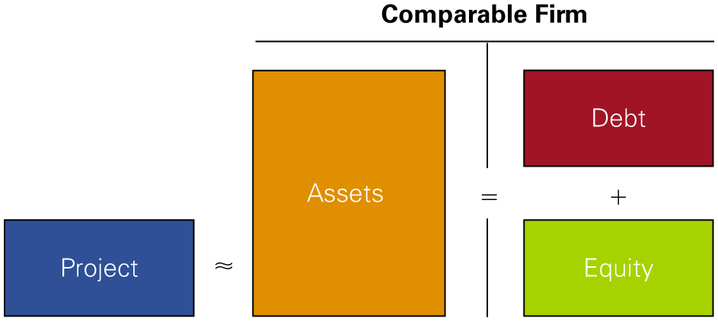
Figure 3
Using a Levered Firm as a Comparable for a Project’s Risk

Slide 41
Example 4 (1 of 2)
Estimating the Beta of a Project from a Single-Product Firm
Problem
You have just graduated with an M B A, and decide to pursue your dream of starting a line of designer clothes and accessories. You are working on your business plan, and believe your firm will face similar market risk to Lululemon (L U L U).
To develop your financial plan, estimate the cost of capital of this opportunity assuming a risk-free rate of 3% and a market risk premium of 5%.

Slide 42
Example 4 (2 of 2)
Solution
Checking Yahoo! Finance, you find that Lululemon has no debt. Using five years of weekly data, you estimate their beta to be 1.2. Using L U L U’s beta as the estimate of the project beta, we can apply the equation tionto estimate the cost of capital of this investment opportunity as
Thus, assuming your business has a similar sensitivity to market risk as Lululemon, you can estimate the appropriate cost of capital as 9%. In other words, rather than investing in the new business, you could invest in the fashion industry simply by buying L U L U stock. Given this alternative, to be attractive, the new investment must have an expected return at least equal to that of L U L U, which from the C A P M is 9%.

Slide 43
5. A Project’s Cost of Capital (3 of 4)
The Unlevered Cost of Capital
  Expected return required by investors to hold the firm’s underlying assets
  The weighted average of the firm’s equity and debt costs of capital can be calculated as:
Asset or Unlevered Cost of Capital

Slide 44
5. A Project’s Cost of Capital (4 of 4)
Unlevered Beta
  Because the beta of a portfolio is the weighted-average of the betas of the securities in the portfolio, we have a similar expression for the firm’s asset or unlevered beta, which we can use to estimate the beta of our project:
Asset or Unlevered Beta

Slide 45
Example 5 (1 of 3)
Unlevering the Cost of Capital
Problem
Your firm is considering expanding its household products division. You identify Procter & Gamble (P G) as a firm with comparable investments. Suppose P G’s equity has a market capitalization of $300 billion and a beta of 0.56. P G also has $35 billion of A A-rated debt outstanding, with an average yield of 3.2%.
Estimate the cost of capital of your firm’s investment given a risk-free rate of 3% and a market risk-premium of 5%.

Slide 46
Example 5 (2 of 3)
Solution
Because investing in the division is like investing in P G’s assets by holding its debt and equity, we can estimate our cost of capital based on P G’s unlevered cost of capital. First, we estimate P G’s equity cost of capital based on P G’s unlevered cost of capital. First, we estimate P G’s
equity cost of capital using the C A P M as
  Because P G’s debt is highly rated, we approximate its debt cost of capital using the debt yield of 3.2%. Thus, P G’s unlevered cost of capital is
  Alternative, we can estimate P G’s unlevered beta. Given its high rating, if we assume P G’s debt is zero we have

Slide 47
Example 5 (3 of 3)
Taking this result as an estimate of the beta of our project, we can compute our project’s cost of capital from the C A P M as
The slight difference in
  using the two methods arises because in the
  first case, we assumed the expected return of P G’s debt is equal to its promised yield of 3.2% (which overestimates the cost of debt, as we pointed out in Section 4), while in the second case, we assumed the debt has a beta of zero, which implies an expected return equal to the risk-free rate of 3% according to the C A P M (which underestimates the cost of debt, because P G’s debt is not risk free). The truth is somewhere between the two results.

Slide 48
Cash and Net Debt
Some firms maintain high cash balances
Cash is a risk-free asset that reduces the average risk of the firm’s assets
Because the risk of the firm’s enterprise value is what we’re concerned with, leverage should be measured in terms of net debt

Slide 49
Example 6 (1 of 2)
Cash and Beta
Problem
In mid-2022, Garmin Ltd. had a market capitalization of $18.8 billion, $100 million in debt, and $1.6 billion in cash. If its estimated equity beta was 0.93, estimate the beta of Garmin’s underlying business enterprise.

Slide 50
Example 6 (2 of 2)
Solution
  Garmin has net
  and thus has
An enterprise value of
Assuming Garmin’s debt and cash investments are both risk-free, we can estimate the beta of this enterprise value as:
Note that in this case, Garmin’s equity is less risky than its underlying business activities due to its cash holdings.
Notes:
Long description:
B sub U baseline equals start fraction E over E plus D end fraction B sub E baseline plus start fraction D over E plus D end fraction B sub D baseline equals start fraction 18.8 over 18.8 minus 1.5 end fraction 0.93 plus start fraction negative 1.5 over 18.8 minus 1.5 end fraction 0 equals 1.01.

Slide 51
Industry Asset Betas
We can combine estimates of asset betas for multiple firms in the same industry
Doing this will reduce the estimation error of the estimated beta for the project

Slide 52
Example 7 (1 of 3)
Estimate an Industry Asset Beta
Problem
Consider the following data for U.S. department stores in mid-2009, showing the equity beta, ratio of net debt to enterprise value (D/V), and debt rating for each firm. Estimate the average and median asset beta for the industry.
Company | Ticker | Equity Beta | D/V | Debt Rating
Dillard’s | D D S | 2.38 | 0.59 | B
JCPenney | J C P | 1 point 60. | 0.17 | B B
Kohl’s | K S S | 1.37 | 0 point 08. | B B B
Macy’s | M | 2.16 | 0.62 | B B
Nordstrom | J W N | 1.94 | 0.35 | B B B
Saks | S K S | 1.85 | 0.50. | C C C
Sears Holding | S H L D | 1.36 | 0.23 | B B

Slide 53
Example 7 (2 of 3)
Solution
Note that
provides the fraction of debt financing, and
the fraction of equity financing, for each firm.
Using the data for debt betas from Table 3, we can apply the equation for each firm. For example, for Dillard’s:
Doing this calculation for each firm, we obtain the following estimates:
Notes:
Long description:
Beta sub U baseline equals start fraction E over E plus D end fraction beta sub E baseline plus start fraction D over E plus D end fraction beta sub D equals left parenthesis 1 minus 0.59 right parenthesis 2.38 plus left parenthesis 0.59 right parenthesis 0.26 equals 1.13.

Slide 54
Example 7 (3 of 3)
Ticker | Equity Beta | D/V | Debt Rating | Debt Beta | Asset Beta
D D S | 2.38 | 0.59 | B | 0.26 | 1.13
J C P | 1 point 60. | 0.17 | B B | 0.17 | 1.36
K S S | 1.37 | 0 point 08. | B B B | 0 point 10. | 1.27
M | 2.16 | 0.62 | B B | 0.17 | 0.93
J W N | 1.94 | 0.35 | B B B | 0 point 10. | 1 point 30.
S K S | 1.85 | 0 point 50. | C C C | 0.31 | 1 point 08.
S H L D | 1.36 | 0.23 | B B | 0.17 | 1 point 09.
 |  |  |  | Average | 1.16
 |  |  |  | Median | 1.13
The large difference in the firms’ equity beta are mainly due to differences in leverage. The firms’ asset beta are much more similar, suggesting that the underlying business in this industry have similar market risk. By combining estimates from several closely related firms in this way can get a more accurate estimate of the beta for investments in the industry.

Slide 55
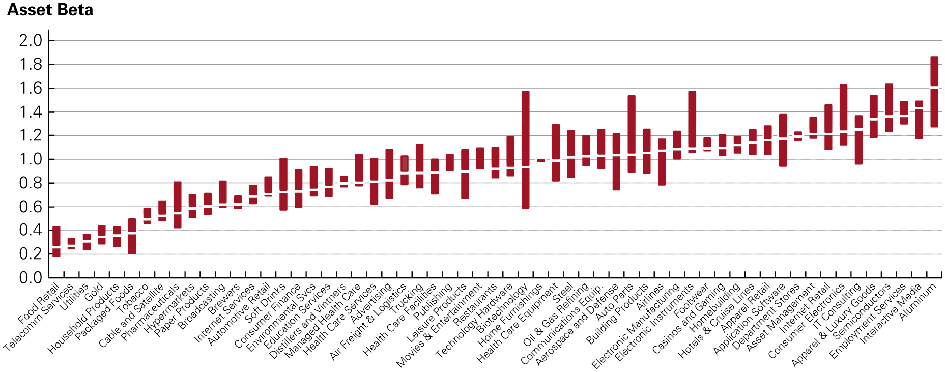
Figure 4
Industry Asset Betas (2022)
Source: Author calculations based on data from Capital I Q.
Notes:
Long Description:
The details of the graph are as follows: X-axis shows select industries and the Y-axis shows asset beta ranging from 0 to 2 in increments of 0.2. It shows utilities- median asset beta: 0.21, upper quartile: 0.3, lower quartile: 0.18; gold-median asset beta: 0.22, upper quartile: 0.26, lower quartile: 0.2; healthcare facilities-median asset beta: 0.37, upper quartile: 0.42, lower quartile: 0.3; packaged foods- median asset beta: 0.5, upper quartile: 0.62, lower quartile: 0.38; household; products- median asset beta: 0.5, upper quartile: 0.62, lower quartile: 0.4; soft drinks- median asset beta: 0.53, upper quartile: 0.62, lower quartile: 0.41; telecommunications- median asset beta: 0.56, upper quartile: 0.6, lower quartile: 0.41; restaurants- median asset beta: 0.56, upper quartile: 0.7, lower quartile: 0.5; tobacco-median asset beta: 0.6, upper quartile: 0.63, lower quartile: null; luxury goods- median asset beta: 0.65, upper quartile: 0.71, lower quartile: 0.58; healthcare services- median asset beta: 0.68, upper quartile: 0.81, lower quartile: 0.6; cable and satellite- median asset beta: 0.7, upper quartile: 0.78, lower quartile: 0.52; superstores- median asset beta: 0.72, upper quartile: 0.81, lower quartile: 0.64; airlines- median asset beta: 0.75, upper quartile: 0.95, lower quartile: 0.68; consumer finance- median asset beta: 0.75, upper quartile: 1.13, lower quartile: 0.6; managed healthcare- median asset beta: 0.77, upper quartile: 1.15, lower quartile: 0.71; leisure products- median asset beta: 0.77, upper quartile: 1.22, lower quartile: 0.42; homebuilding- median asset beta: 0.76, upper quartile: 0.88, lower quartile: 0.75; department stores- median asset beta: 0.78, upper quartile: 0.82, lower quartile: 0.68; farm machinery-median asset beta: 0.79, upper quartile: 0.86, lower quartile: 0.65; healthcare equipment- median asset beta: 0.8, upper quartile: 0.93, lower quartile: 0.7; oil and gas-median asset beta: 0.8, upper quartile: 1.08, lower quartile: 0.65; broadcasting- median asset beta: 0.8, upper quartile: 0.85, lower quartile: 0.79; apparel retail- median asset beta: 0.81, upper quartile: 0.95, lower quartile: 0.71; entertainment- median asset beta: 0.83, upper quartile: 0.9, lower quartile: 0.7; casinos and gaming- median asset beta: 0.82, upper quartile: 0.96, lower quartile: 0.79; hotels and resorts- median asset beta: 0.87, upper quartile: 0.97, lower quartile: 0.81; pharmaceuticals- median asset beta: 0.9, upper quartile: 1.17, lower quartile: 0.72; home furnishings- median asset beta: 0.9, upper quartile: 1.05, lower quartile: 0.82; internet software- median asset beta: 0.88, upper quartile: 1.06, lower quartile: 0.79; paper products- median asset beta: 0.92, upper quartile: 1.08, lower quartile: 0.8; aerospace and defense- median asset beta: 0.94, upper quartile: 1.06, lower quartile: 0.74; trucking- median asset beta: 0.95, upper quartile: 1.18, lower quartile: 0.82; automakers-median asset beta: 0.96, upper quartile: 1.28, lower quartile: 0.66; air freight and logistics- median asset beta: 0.96, upper quartile: 1.14, lower quartile: 0.84; publishing- median asset beta: 0.96, upper quartile: 1.3, lower quartile: 0.85; it consulting- median asset beta: 1, upper quartile: 1.4, lower quartile: 0.95; electronics retail-median asset beta: 1.01, upper quartile: 1.18, lower quartile: 0.83; chemicals- median asset beta: 1.02, upper quartile: 1.21, lower quartile: 0.79; application software- median asset beta: 1.08, upper quartile: 1.16, lower quartile: 0.94; household appliances- median asset beta: 1.07, upper quartile: 1.32, lower quartile: 0.92; construction- median asset beta: 1.08, upper quartile: 1.21, lower quartile: 0.99; tech. hardware-median asset beta: 1.1, upper quartile: 1.52, lower quartile: 1.1; office services-median asset beta: 1.1, upper quartile: 1.32, lower quartile: 0.75; electronic manufacturing-median asset beta: 1.1, upper quartile: 1.21, lower quartile: 1.48; building products- median asset beta: 1.13, upper quartile: 1.43, lower quartile: 0.95; industrial machinery- median asset beta: 1.13, upper quartile: 1.34, lower quartile: 1.1; auto parts- median asset beta: 1.19, upper quartile: 1.28, lower quartile: 0.92; comm. equipment- median asset beta: 1.22, upper quartile: 1.48, lower quartile: 0.9; internet retail- median asset beta: 1.22, upper quartile: 1.28, lower quartile: 0.96; semiconductors- median asset beta: 1.3, upper quartile: 1.55, lower quartile: 1.02; steel-median asset beta: 1.4, upper quartile: 1.72, lower quartile: 1.26; employment services- median asset beta: 1.45, upper quartile: 1.68, lower quartile: 1.3; asset management- median asset beta: 1.5, upper quartile: 1.79, lower quartile: 1.28.

Slide 56
6. Project Risk Characteristics and Financing (1 of 3)
Differences in Project Risk
  Firm asset betas reflect market risk of the average project in a firm
  Individual projects may be more or less sensitive to market risk

Slide 57
6. Project Risk Characteristics and Financing (2 of 3)
For example, 3M has a healthcare division, a transportation division, and an electronics division
3M’s own asset beta represents an average of the risk of these and 3M’s other divisions
Financial managers in multidivisional firms should evaluate projects based on asset betas of firms in a similar line of business

Slide 58
6. Project Risk Characteristics and Financing (3 of 3)
Another factor that can affect market risk of a project is its degree of operating leverage
Operating leverage is the relative proportion of fixed versus variable costs
A higher proportion of fixed costs increases the sensitivity of the project’s cash flows to market risk
  The project’s beta will be higher
  A higher cost of capital should be assigned

Slide 59
Example 8 (1 of 3)
Operating Leverage and Beta
Problem
Consider a project with expected annual revenues of $120 and costs of $50 in perpetuity. The costs are completely variable, so that the profit margin of the project will remain
constant. Suppose the project has a beta of
the risk-free
rate is 5%, and the expected return of the market is 10%. What is the value of this project? What would its value and beta be if the revenues continued to vary with a beta of 1.0, but the costs were instead completely fixed at $50 per year?

Slide 60
Example 8 (2 of 3)
Solution
The expected cash flow of the project is
per year.
Given a beta of
the appropriate cost of capital is
Thus, the value of the project if the costs are
completely variable is
If instead the costs are fixed, then we can compute the value of the project by discounting the revenues and costs separately. The revenues
still have a beta of
and thus a cost of capital of 10%, for a present
value of
Because the costs are fixed, we should discount
them at the risk-free rate of 5%, so their present value is
Thus, with fixed costs the project has a value of only

Slide 61
Example 8 (3 of 3)
What is the beta of the project now? We can think of the project as a portfolio that is long the revenues and short the costs. The project’s beta is the weighted average of the revenue and cost betas, or
Given a beta of 6.0, the project’s cost of capital with fixed costs is
  To verify this result, note that the present value
of the expected profits is then
    As this example shows, increasing the proportion of fixed versus variable costs can significantly increase a project’s beta (and reduce its value).
Notes:
Long description:
Beta sub p baseline equals start fraction upper R over upper R minus upper C end fraction beta sub upper R baseline minus start fraction upper C over upper R minus upper C end fraction beta sub upper C baseline equals start fraction 1200 over 1200 minus 1000 end fraction 1.0 minus start fraction 1000 over 1200 minus 1000 end fraction 0 equals 6.0.

Slide 62
Financing and the Weighted Average Cost of Capital
How might the project’s cost of capital change if the firm uses leverage to finance the project?
Perfect Capital Markets
  In perfect capital markets, choice of financing does not affect cost of capital or project N P V
Taxes – A Big Imperfection
  When interest payments on debt are tax deductible, the net cost to the firm is given by

Slide 63
The Weighted Average Cost of Capital (1 of 2)
The Weighted Average Cost of Capital (W A C C)
D
Given a target leverage ratio,
Notes:
Long description:
r sub w a c c baseline equals start fraction upper E over upper E plus upper D end fraction r sub upper E baseline plus start fraction upper E over upper E plus upper D end fraction r sub upper D baseline left parenthesis 1 minus tau sub upper C baseline right parenthesis.

Slide 64
The Weighted Average Cost of Capital (2 of 2)
How does
compare with
  Unlevered cost of capital (or pretax W A C C)
    Expected return investors will earn by holding the firm’s assets
    In a world with taxes, it can be used to evaluate an all-equity project with the same risk as the firm
  In a world with taxes, W A C C is less than the expected return of the firm’s assets
    With taxes, W A C C can be used to evaluate a project with the same risk and the same financing as the firm

Slide 65
Example 9 (1 of 2)
Estimating the W A C C
Problem
Dunlap Corp. has a market capitalization of $100 million, and $25 million in outstanding debt. Dunlap’s equity cost of capital is 10%, and its debt cost of capital is 6%. What is Dunlap’s unlevered cost of capital? If its corporate tax rate is 25%, what is Dunlap’s weighted average cost of capital?

Slide 66
Example 9 (2 of 2)
Solution
Dunlap’s unlevered cost of capital, or pretax W A C C , is given by
Thus, we would use a cost of capital of 9.2% to evaluate all-equity financed project with the same risk as Dunlap’s assets.
Dunlap’s weighted average cost of capital, or W A C C , can be calculated using equations.
We can use the W A C C of 8.9% to evaluate with the same risk and the same mix of debt and equity financing as Dunlap’s assets. It is a lower rate than the unlevered cost of capital to reflect the tax deductibility of interest expenses.
Notes:
Long description 1:
r sub upper U baseline equals start fraction upper E over upper E plus upper D end fraction r sub upper E baseline plus start fraction upper D over upper E plus upper D end fraction r sub upper D baseline equals start fraction 100 over 125 end fraction 10 percent plus start fraction 25 over 125 end fraction 6 percent equals 9.2 percent.
Long description 2:
r sub w a c c baseline equals start fraction upper E over upper E plus upper D end fraction r sub upper E baseline plus start fraction upper E over upper E plus upper D end fraction r sub upper D baseline left parenthesis 1 minus tau sub upper C baseline right parenthesis equals start fraction 100 over 125 end fraction 10 percent plus start fraction 25 over 125 end fraction 6 percent left parenthesis 1 minus 25 percent right parenthesis equals 8.9 percent.
Long description 3:
Equals r u minus start fraction upper D over upper E plus upper D end fraction tau sub upper C baseline r sub upper D equals 9.2 percent minus start fraction 25 over 125 end fraction left parenthesis 25 percent right parenthesis 6 percent equals 8.9 percent.

Slide 67
7. Final Thoughts on Using the C A P M (1 of 2)
There are a large number of assumptions made in the estimation of cost of capital using the C A P M
How reliable are the results?

Slide 68
7. Final Thoughts on Using the C A P M (2 of 2)
The types of approximation are no different from those made throughout the capital budgeting process
  Errors in cost of capital estimation are not likely to make a large difference in N P V estimates
C A P M is practical, easy to implement, and robust
C A P M imposes a disciplined approach to cost of capital estimation that is difficult to manipulate
C A P M requires managers to think about risk in the correct way

Slide 69
Quiz (1 of 3)
What inputs do we need to estimate a firm’s equity cost of capital using the C A P M?
How do you determine the weight of a stock in the market portfolio?
How can you estimate the market risk premium?
How can you estimate a stock’s beta from historical returns?

Slide 70
Quiz (2 of 3)
Why does the yield to maturity of a firm’s debt generally overestimate its debt cost of capital?
Describe two methods that can be used to estimate a firm’s debt cost of capital.
What data can we use to estimate the beta of a project?
Why does the equity beta of a levered firm differ from the beta of its assets?

Slide 71
Quiz (3 of 3)
Why might projects within the same firm have different costs of capital?
Even if the C A P M is not perfect, why might we continue to use it in corporate finance?

